Slide 1
N400 Differences Between Associative and Semantically Primed Word Pairs
By Nathan Nunley
University of Mississippi

Slide 2
Reasons for Experiments
Priming – is it automatic or controlled?
Priming – semantic or associative?
Our study
Understanding priming for different word types
Understanding priming in the brain versus reaction time data
Use that information to answer automatic versus controlled

Slide 3
Experiment Participants
20 English speaking undergraduate students(13 women and 7 men)
Two Participants’ data were unusable, leaving 18 participants (12 women and 6 men)
Notes:
All participants signed consent forms
No participants received compensation for participation

Slide 4
Apparatus
32 Channel EEG Cap and NuAmps Monopolar Digital Amplifier
SCAN 4.5 and Stim² Software for data collection and processing

Slide 5
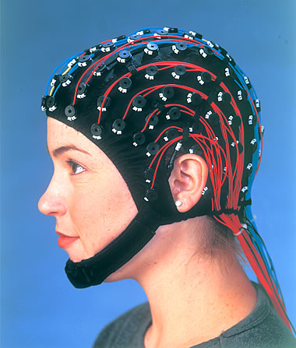
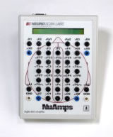

Slide 6
Materials
180 Word Pairs
Unrelated word pairs (60)
Semantically related word pairs (30)
Associatively related word pair (30)
Nonword pairs (60)

Slide 7
Materials
Unrelated: Remorse – Blot
Semantic: Length – Size
Associative: Lather – Soap
Nonword: Knot - Coid

Slide 8
Procedure
5 minute blocks with breaks (6 blocks)
LDT
Is this a word or nonword?
LST
Does this word have repeating letters or not?

Slide 9
Example
Lexical Decision
OSS would be no
NIGHT would be yes
Letter Search
PAWN would be no
GORILLA would be yes

Slide 10
Data Processing
EEGLAB, a MATLAB tool was used to remove muscular artifacts (eyeblinks)
Datasets were manually inspected for remaining corrupted portions
Ninety percent of the data was retained
Data was combined by task and stimulus type exclusively for the second word in each pair

Slide 11
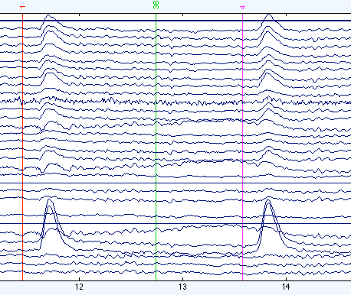
Bad Data Example

Slide 12
Lexical Decision Task Hypotheses
Non-word pairs < Unrelated
Slower because you have to search for the information
Semantic word pairs > Unrelated
Faster due to priming
Associative word pairs < or > Unrelated
Faster due to priming or slower due to different network

Slide 13
Lexical Decision Task Results
Non-words < Unrelated at crown
Semantic word pairs > Unrelated at crown
Associative word pairs > Unrelated
Some priming at the neural level, but were only significant at p<.10 levels

Slide 14
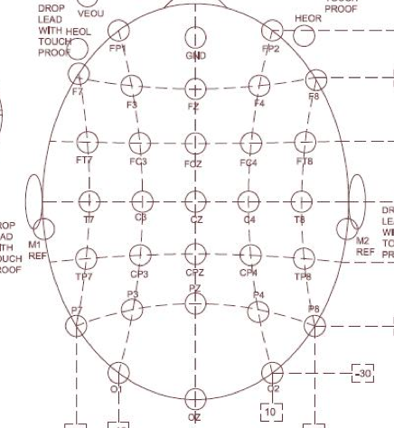

Slide 15
Lexical Decision Task CZ, CPZ Values
Table 1.
Mean, Standard Errors, and t-value differences from zero for the Lexical Decision Task.
 | M | SE | t | p
CZ
Non-words | -171.506 | 68.665 | -2.498 | 0.023
Associative | 117.840 | 67.121 | 1.756 | 0.097
Semantic | 124.051 | 52.756 | 2.351 | 0.031
CPZ
Non-words | -166.015 | 54.220 | -3.062 | 0.007
Associative | 80.063 | 56.047 | 1.428 | 0.171
Semantic | 113.651 | 51.669 | 2.200 | 0.042

Slide 16
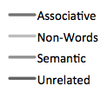
Lexical Decision Task N400 Waveform Averages for CZ, CPZ
CZ
CPZ

Slide 17
Letter Search Task Hypotheses
Non-word pairs < Unrelated
Due to novelty and need to search word
Semantic and associative word pairs < or > Unrelated
Priming would cause < activation.
But LST should decrease automatic activation, so may be > values.

Slide 18
Letter Search Task Results
Non-words > Unrelated at crown again.
The effects for semantic and associative word pairs are difficult to interpret due to low significance values.
LST eliminates priming in N400?
Small sample size?

Slide 19
Blue denotes significant NW effect.
Red denotes trends for Sem and Assoc.

Slide 20
Letter Search Task Values
Table 2.
Mean, Standard Errors, and t-value differences from zero for the Letter Search Task.
 | M | SE | t | p
CZ
Non-words | -85.508 | 44.338 | -1.929 | 0.071
CPZ
Non-words | -107.266 | 42.753 | -2.509 | 0.023
FZ
Associative | -7.768 | 40.831 | -0.190 | 0.851
Semantic | 52.965 | 50.094 | 1.057 | 0.305
FCZ
Associative | -2.566 | 37.069 | -0.069 | 0.946
Semantic | 54.958 | 49.622 | 1.108 | 0.283
PZ
Associative | 69.862 | 64.407 | 1.085 | 0.293
Semantic | 58.977 | 42.259 | 1.396 | 0.181

Slide 21
Letter Search Task N400 Averages for CZ, CPZ
CZ
CPZ

Slide 22
Letter Search Task N400 Averages for FZ, FCZ, PZ
FCZ
FZ
PZ

Slide 23
Task Performance Data
Task Data were analyzed for correctness in both tasks individually
Error rates were tested with a 2X4 repeated measures ANOVA
Overall, performance was equal on both tasks and the interaction between task type and stimuli was not significant
Notes:
We have the means if asked for.

Slide 24
Reaction Time Data
Average reaction times were calculated for each task type and stimulus
Associative, semantic, and non-word conditions were subtracted from their matching unrelated word conditions
Each stimulus difference was analyzed with a single sample t-test against zero to examine priming

Slide 25
Priming Reaction Times for Both Experiments
*
*
*
*
*
Notes:
LST
All conditions in the LST were significantly primed over unrelated pairs
Associative and semantic word pairs were about 200 msecs faster than unrelated word pairs, while non-words were roughly 200 msecs slower than unrelated word pairs
Due to previous research, it is somewhat surprising that semantic word pairs were primed during the LST, but the current word list showed similar effect in Buchanan (2010). This data does not match the N400 waveform, which will be discussed in the conclusion
LDT
Priming was observed in associative word pairs for the LDT (120 msecs faster than unrelated), a marginal effect was found for semantic word pairs (85 msecs faster than unrelated), and a slowing for non-word pairs when compared to unrelated word pairs (200 msecs slower)
Lack of semantic priming seems to be due to the small sample size of this experiment

Slide 26
Conclusions
Semantic priming in the brain (N400 data) during LDT
Probably automatic
Only marginally seen for reaction time data (sample size?)
Semantic priming in reaction time data for LST
Probably controlled since not seen in N400 data

Slide 27
Conclusions
Associative priming in reaction time data for LST and LDT
Probably controlled since automatic N400 activation is in expected direction but not significant.

Slide 28
Conclusion continued
Controlled processing is seen in N400 and reaction time data for non-words

Slide 29
Future Implications
Past research has focused on whether priming effects are due to automatic or controlled processes for all types of words, but the findings of this study indicate a need for research into distinguishing what type of process is used for different types of word relationships

Slide 30
Questions?

Slide 31
Extra Slides if Asked

Slide 32
Descriptive Statistics for Task Performance
 | M | SD
Letter Search
Non-Words | 0.95 | 0.02
Unrelated Words | 0.97 | 0.02
Associated Words | 0.97 | 0.03
Semantic Words | 0.98 | 0.02
Lexical Decision task
Non-Words | 0.94 | 0.05
Unrelated Words | 0.98 | 0.02
Associated Words | 0.99 | 0.01
Semantic Words | 0.98 | 0.03

